Slide 1
Azure Adversarial Posture Review
Presented by CyberSurance
CISSP · CISA · OSCP · GXPN · CARTP
1

Slide 2
The gap in cloud identity posture
Microsoft-native posture (Secure Score, Microsoft Entra Identity Protection) scores the tenant on
Microsoft's hygiene rules. Vendor floor. Does not critique Microsoft's own architectural choices.
Generalist audits (Big Four, incident-response firms) are annual, six-figure, custom-scoped. Twelve
months between snapshots.
Nothing lives in between.
2

Slide 3
What Azure Adversarial Posture Review is
A non-intrusive, MITRE-mapped assessment of your Microsoft Entra and Azure RBAC tenant.
Attacker vantage. Same offensive tooling a current adversary would use to enumerate the tenant.
Defender authorization. Read-only. No agents. No exploitation attempts. No IR coordination.
Adversary-calibrated. Every finding mapped to MITRE ATT&CK and attack chain stages.
3

Slide 4
How it works
Read-only collection
25+ analyzers
MITRE-mapped
ROADtools + AzureHound
Policy · Identity ·
Word + HTML + JSON
export from customer tenant
Application · Privilege
reports
Static analysis of the read-only export. Once collection completes, all further review happens offline. No
live tenant interaction.
4

Slide 5
What a finding chain looks like
Password Spray → Tenant Takeover (from a real scan template)
INITIAL ACCESS
CREDENTIAL ACCESS
PRIVILEGE ESCALATION
AAPR-PO-002
AAPR-ID-001
AAPR-ID-006
Legacy authentication
Users without MFA
Excessive Global
not blocked
registered
Administrators
Outcome: Full Tenant Compromise
5

Slide 6
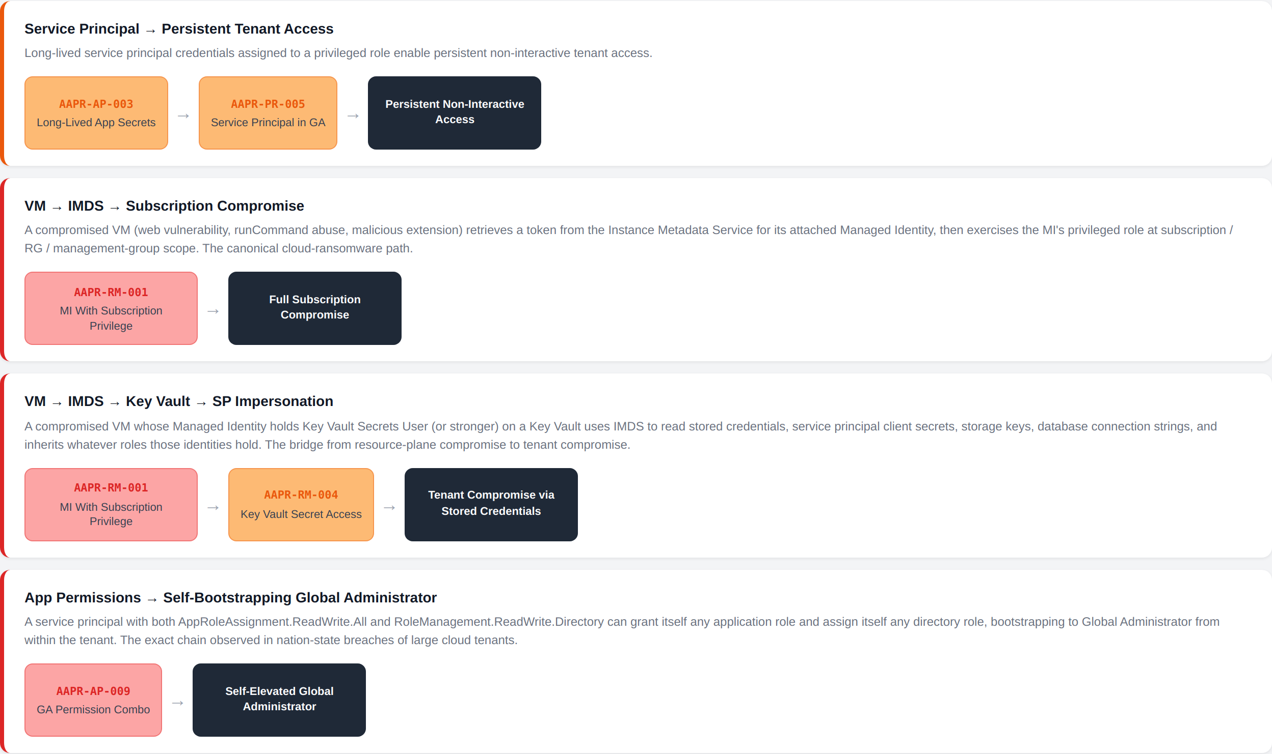
Report renders the whole catalog
Excerpt: Attack Paths section from a sample scan. Each card is generated automatically from the findings present in the tenant.
6

Slide 7
Coverage
25+ checks across four categories. Every finding tagged with attack chain stages and MITRE ATT&CK
techniques.
Category
What it covers
Policy (
)
Security Defaults, Conditional Access, MFA enforcement, legacy auth, guest invitation, OAuth consent, app
AAPR-PO-*
registration permissions
Identity (
)
MFA registration, stale privileged accounts, guests in admin roles, disabled-but-role-assigned accounts, Global
AAPR-ID-*
Admin count
Application (
AAPR-
Dangerous API permissions, app owner escalation, long-lived credentials, high-privilege app secrets
AP-*
)
Privilege (
AAPR-PR-
Permanent (vs. PIM-eligible) role assignments, nested groups in privileged roles, cross-tenant access, service
*
)
principals with directory roles
7

Slide 8
What you receive
Board-ready Word document. TOC, executive summary, tenant health snapshot, MITRE and
attack chain coverage matrix, ranked attack paths, remediation tiered Immediate / Short-term / Long-
term.
Interactive HTML report. Self-contained, no external dependencies, opens in any browser. Attack-
path visualization included.
JSON output. For pipeline integration with ticketing and detection tooling.
Trend view (subscribers). Quarter-over-quarter comparison across the engagement lifetime.
8

Slide 9
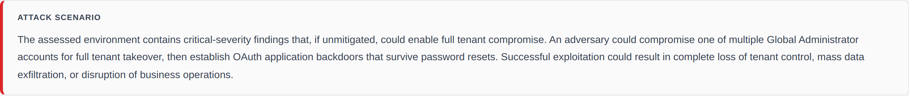
Executive summary opens with an attack scenario
Excerpt: Attack Scenario paragraph the CISO reads first. Composed automatically from the highest-severity findings in the tenant.
9

Slide 10
Tenant posture at a glance
Excerpt: Tenant Health Snapshot. Traffic-light view of the load-bearing controls (Security Defaults, Conditional Access, MFA,
legacy auth, MFA registration, Global Admin count).
10

Slide 11
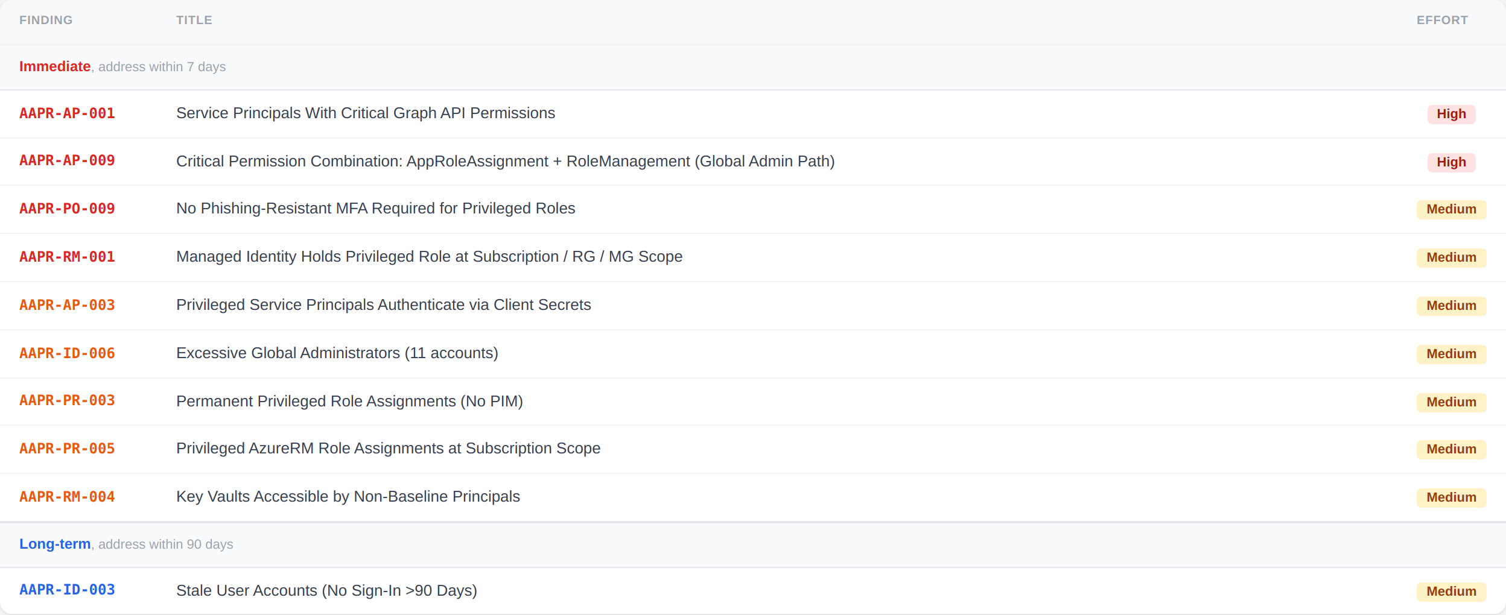
Remediation priority, tiered by urgency
Excerpt: Remediation Priority table. Findings ranked Immediate / Short-term / Long-term with per-finding effort tags.
11

Slide 12
Remediation starts from what you already own
Every finding names the Microsoft Entra ID or Microsoft 365 capability that addresses it, cross-referenced
against your tenant's existing license entitlements.
Owned
capability is already in your entitlement
Not owned (Microsoft Entra ID P2)
capability requires the named SKU tier
The remediation conversation starts with what you already own. Not with a request for additional spend.
12

Slide 13
The catalog moves with the adversary
Quarterly threat-intel sweep. New tradecraft (consent phishing patterns, AiTM, service principal
credential abuse, cross-tenant OAuth) reviewed against the finding catalog every quarter.
Retire what's no longer live. When a CVE gets patched or a technique class stops appearing in
reporting, the corresponding finding is demoted or removed.
Independent of vendor scoring. Findings surface the RBAC graph and transitive blast radius that
vendor-native scoring does not model.
13

Slide 14
Where Azure Adversarial Posture Review fits
Vs. Microsoft-native posture (Secure Score, Microsoft Entra Identity Protection, Defender).
Those tools are the floor every Entra customer already has. They will not critique Microsoft's own
architectural choices. Azure Adversarial Posture Review is the adversarial layer on top: independent,
vendor-neutral, mapped to current tradecraft.
Vs. generalist consulting engagements (Big Four, incident-response firms).
Not a replacement for a broad multi-domain audit. The right call for keeping cloud identity posture current
between those engagements, or as the primary cadence when the budget will not support a six-figure
audit at all.
14

Slide 15
Engagement model
One-time
Quarterly subscription
Deliverable
Full report (Word + HTML + JSON)
Full report each quarter
Cadence
Point-in-time snapshot
Every 90 days
Trend view
Not included
Quarter-over-quarter comparison
Price
Low five figures
Discounted quarterly rate
Turnaround
Days, not months
Same
Scope: Microsoft Entra tenant + Azure RBAC subscriptions in-scope for the engagement.
15

Slide 16
Proposed pilot
1. Scoping call (30 min). Confirm in-scope tenant and subscription list. Identify the collection identity
owner on your side.
2. Grant collection scopes. Microsoft Graph read permissions for ROADtools; Azure Reader for
AzureHound. Your team runs the collection or we can run it under a temporary account.
3. Analysis (5 business days). We process the export, calibrate findings against your license
entitlements, produce all report formats.
4. Readout (60 min). Walk the report with your identity and detection teams. Q&A. Remediation
prioritization.
First engagement to readout: ~2 weeks end-to-end
16

Slide 17
Questions
CyberSurance
17

